Slide 1
Chapter 14:
Files and Streams

Slide 2
Objectives
Learn about computer files and the File and Directory classes.
Understand file data organization.
Understand streams.
Write to and read from a sequential access text file.
Search a sequential access text file.
Understand serialization and deserialization.

Slide 3
Files and the File and Directory Classes
Temporary storage is usually called computer memory or random access memory (RAM).
Variables created in a C# program use temporary storage.
Temporary storage is volatile because values are lost when the program ends or power is lost.
Permanent storage, on the other hand, is nonvolatile because nothing is lost when a computer loses power.
When you write a program and save it to disk, you are using permanent storage.

Slide 4
Files and the File and Directory Classes
A computer file is a collection of information stored on a nonvolatile device in a computer system.
Files exist on permanent storage devices, such as hard disks, USB drives, reels of magnetic tape, and optical discs (CDs and DVDs).
Text files contain information encoded in ASCII or Unicode characters.
Text files can be read using a text editor.
Text files can be data files or source code files.

Slide 5
Files and the File and Directory Classes
Binary files contain data that has not been encoded as text.
Their contents are encoded in binary format, which means that you cannot understand them by viewing them using a text editor.
Examples include images, music, and compiled program files with an .exe extension.

Slide 6
Files and the File and Directory Classes
Common characteristics of a file:
Has a name that often includes a dot and an extension that describes the type of file.
Has a specific time of creation and a time it was last modified.
Occupies space on a section of a storage device – that is, it has a size that is measured in bytes.

Slide 7
Files and the File and Directory Classes
When you store data in a file on a persistent storage device, you write to the file.
When you copy data from a file on a storage device into RAM, you read from the file.
Computer users organize their files into folders or directories.

Slide 8
Files and the File and Directory Classes
A path is a combination of the disk drive plus the complete hierarchy of directories in which a file resides.
E:\workspace\Chapter14\MyFile.txt
The C# language provides built-in classes named File and Directory that contain methods to help you manipulate files and their directories respectively.

Slide 9
Using the File and Directory Classes
The File class contains methods to access information about files.
The File class is contained in the System.IO namespace.
The Directory class provides information about directories or folders.

Slide 10
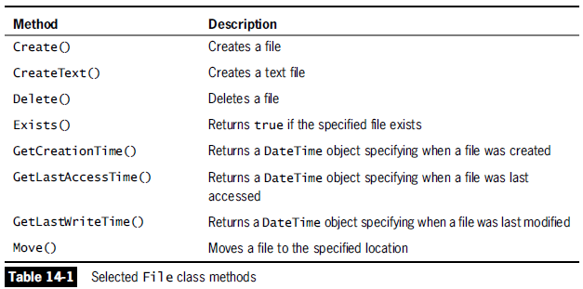
Using the File and Directory Classes

Slide 11
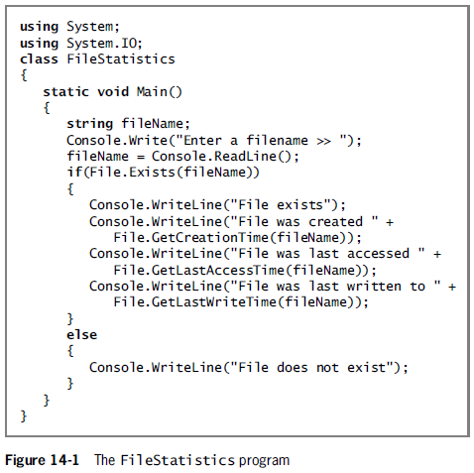

Slide 12
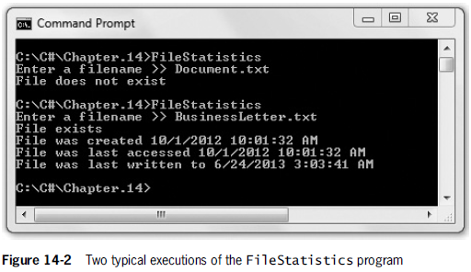
Using the File and Directory Classes

Slide 13
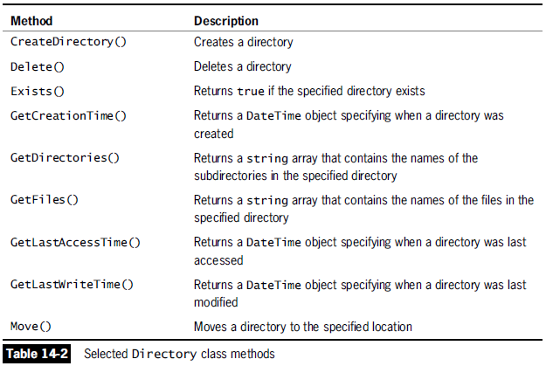
Using the File and Directory Classes

Slide 14
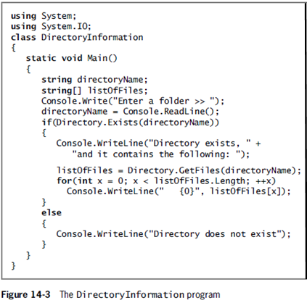

Slide 15
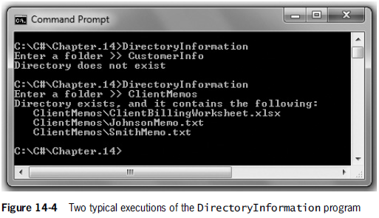
Using the File and Directory Classes

Slide 16
Understanding File Data Organization
Businesses store data in a relationship known as the data hierarchy – how data is related.
A character is any of the letters, numbers, or other special symbols (such as punctuation marks) that comprise data.
Characters are made up of bits (the zeros and ones that represent computer circuitry).

Slide 17
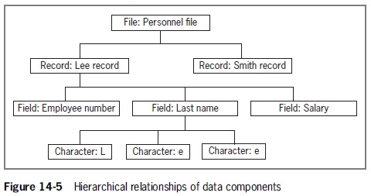
Understanding File Data Organization

Slide 18
Understanding File Data Organization
A field is a character or group of characters that has some meaning.
A record is a collection of related fields that contain data about an entity.
A data file consists of a group of related records.
In a sequential access file each record in the file is read in order based on its relative position in the file.
Records can be stored in a sequential access file in order based on a unique field value – known as a key field.

Slide 19
Understanding File Data Organization
A C# application opens a file by creating an object and associating a stream of bytes with that object.
When you finish using a file, the program should close the file – that is, make it no longer available to your application.
Not closing an output file may make it inaccessible in the future and it may cause data not to be written to the file.
Failing to close an input file has no real consequences, but it is a good programming practice to close input files.

Slide 20
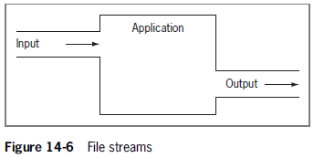
Understanding Streams
A stream functions as a pipeline or channel between an input device and an application, and potentially an output device.

Slide 21
Understanding Streams
Default stream objects in C#:
Console.In accepts data from the keyboard.
Console.Out allows a program to produce output on the screen.
Console.Error allows a program to write error messages to the screen.

Slide 22
Understanding Streams
Most streams flow in only one direction.
File processing classes that flow in one direction:
StreamReader for text input from a file.
StreamWriter for text output to a file.
File processing class that flow in both directions:
FileStream for both input from and output to a file.

Slide 23
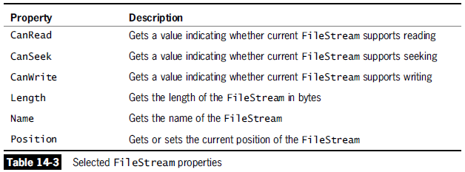
Understanding Streams

Slide 24
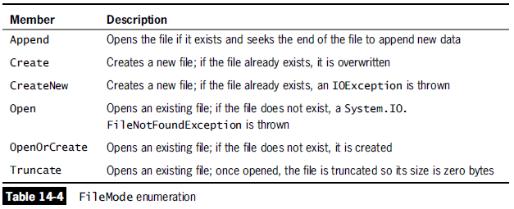
Understanding Streams

Slide 25
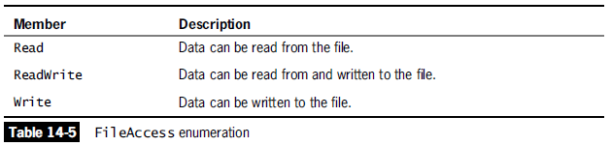
Understanding Streams

Slide 26
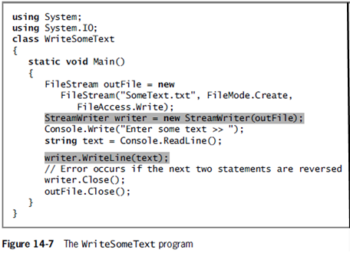
Understanding Streams

Slide 27
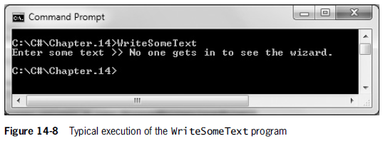
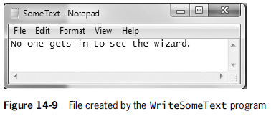
Understanding Streams

Slide 28
Writing and Reading a Sequential Access File
Although most people think of data files as consisting of records that contain fields, C# uses files only as streams of bytes.
Therefore, when you write a program that writes data to a data file, or reads data from an already created data file, you must dictate the form in which the program will handle the file.
Whether you are writing data to a data file or reading data from a data file, you must create a FileStream object.

Slide 29
Writing Data to a Sequential Access Text File
A block of text within a string that represents an entity or field is a token.
The character used to separate tokens is called a delimiter.
In other words – a character used to specify the boundary between records and fields in text files.
Without a delimiter, the process of separating and interpreting tokens is more difficult.

Slide 30
Writing Data to a Sequential Access Text File
A comma is a commonly used delimiter, but a delimiter can be any character that is not needed as part of the data in a file.
CSV files (Comma-Separated Value) are delimited files.
Delimiters are needed when fields are not fixed in size and position (field size varies).
To write data to a data file, you use the FileStream class and the StreamWriter class.
FileStream outFile = new FileStream(FILENAME, FileMode.Append, FileAccess.Write);

Slide 31
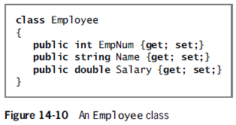
Writing Data to a Sequential Access Text File

Slide 32
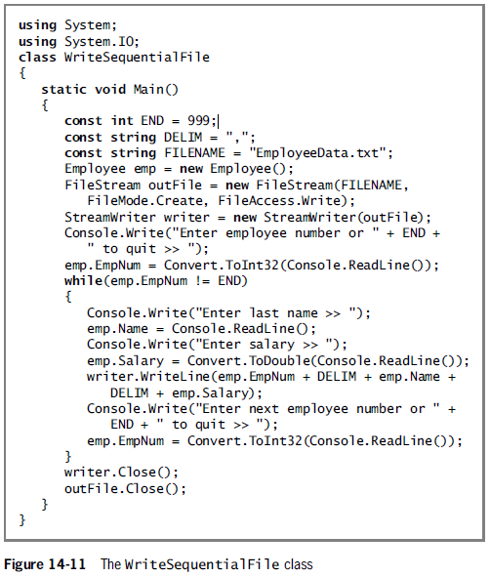

Slide 33
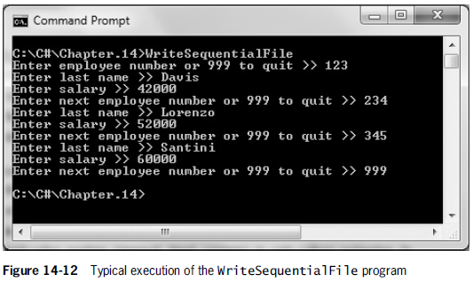
Writing Data to a Sequential Access Text File

Slide 34
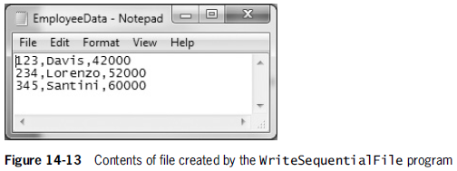
Writing Data to a Sequential Access Text File

Slide 35
Reading from a Sequential Access Text File
A program that reads from a sequential access data file contains many similar components to one that writes to a file – therefore reading from a text file is similar to writing to a text file.
To read data from a data file, you use the FileStream class and the StreamReader class.
FileStream inFile = new FileStream(FILENAME, FileMode.Open, FileAccess.Read);

Slide 36
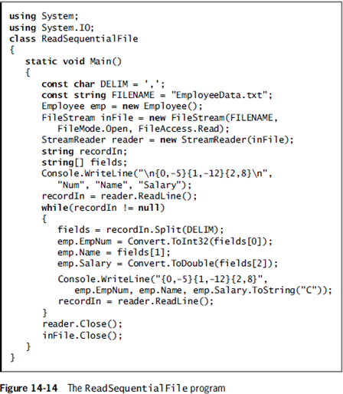

Slide 37
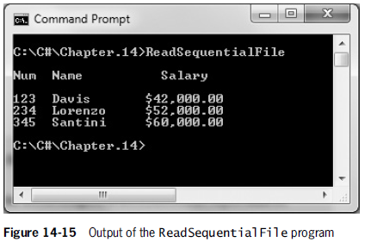
Reading from a Sequential Access Text File

Slide 38
Searching a Sequential Text File
The file position pointer holds the byte number of the next byte to be read.
Sometimes it is necessary to process a file multiple times from the beginning during a program’s execution.
To reposition the file pointer to the beginning of the file, use the Seek()method and the SeekOrigin enumeration.

Slide 39
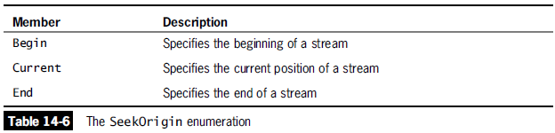
Searching a Sequential Text File
The following statement repositions the pointer of a file named inFile to 0 bytes away from the Begin position of the file.
inFile.Seek(0, SeekOrigin.Begin);

Slide 40
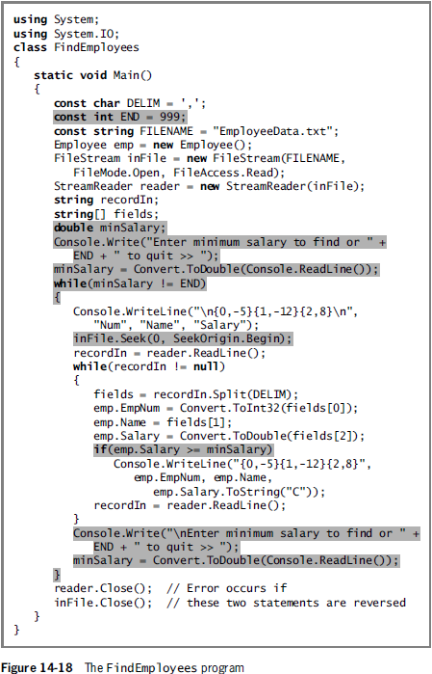

Slide 41
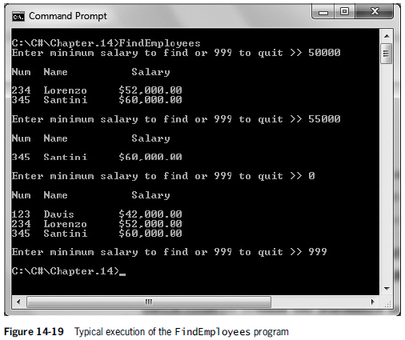
Searching a Sequential Text File

Slide 42
Understanding Serialization and Deserialization
Writing to a text file allows you to store data for later use.
However, writing to a text file does present two disadvantages:
Data in a text file is easily readable when you use a text editor (Notepad), but it is not very secure.
It is cumbersome to convert each field to text and combine the fields with delimiters before storing the record on a disk.

Slide 43
Understanding Serialization and Deserialization
Writing an entire object to a file at once and reading an entire object would be more convenient.
Serialization is the process of converting objects into streams of bytes.
Deserialization is the reverse process, it converts streams of bytes back into objects.

Slide 44
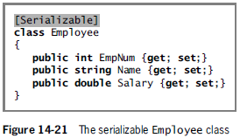
Understanding Serialization and Deserialization

Slide 45
Understanding Serialization and Deserialization
To create a class that can be serialized, mark it with the [Serializable] attribute.
Every instance variable must also be serializable. Luckily, all of C#’s simple data types are serializable, including strings.
Namespaces included in programs that employ serialization:
System.Runtime.Serialization.Formatters.Binary;
System.Runtime.Serialization;

Slide 46
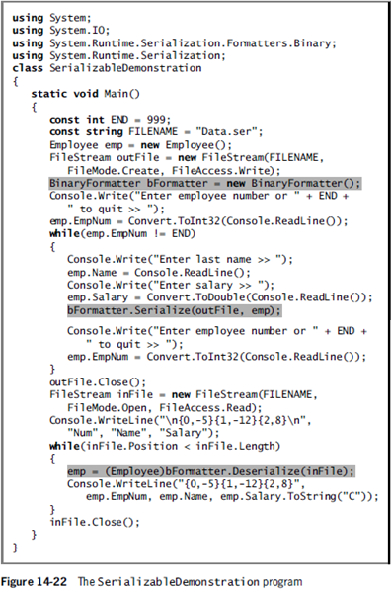

Slide 47
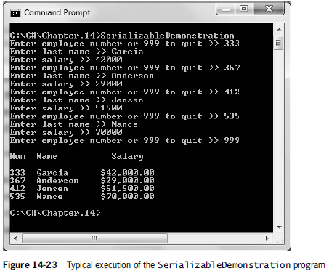
Understanding Serialization and Deserialization

Slide 48
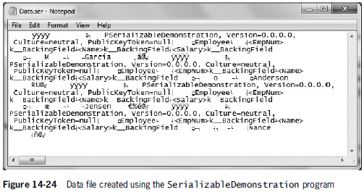
Understanding Serialization and Deserialization

